Slide 1
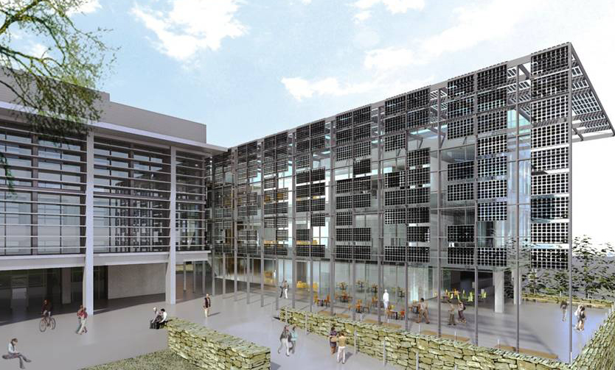

Thermal and Electrochemical Energy Laboratory (TEEL)
Abel Chuang

Slide 2
TEEL Laboratory Vision Statement
Vision
Make Positive Impact on Technology and People
by performing cutting-edge research and producing engineers with desirable skills and positive attitude.

Slide 3
TEEL Laboratory Mission Statement
Mission
We recruit and train students and scholars to generate impactful patents, publications, and products by performing unique and innovative researches in thermal and electrochemical technologies.

Slide 4

TEEL Laboratory Values
Pursue excellence through hard work
Take initiatives
Be on time
Be respectful and thankful
Be responsible and accountable
Team above individual
Always do your best
Always speak the truth
It’s ok to say “I don’t know”
Admit mistakes instead of find excuses
Find solutions instead of complaining
If you don’t agree with or have questions related to these values, please schedule a meeting to discuss with the professor.

Slide 5
TEEL Laboratory Rules
Be safe (No open-toe shoes, loose clothes, shorts, etc.).
Learn to use the eyewash fountain and safety shower.
Evacuate if alarm sounds.
Follow manuals and SOPs for equipment operation.
Use safety goggles and lab aprons as instructed.
Use care when handling chemicals.
Report all accidents regardless of how minor to PI.
Return all tools and materials and clean up after your work.
Keep a focus on your projects and experiments.
Take notes of your experiment.
Respect other laboratory members.

Slide 6
TEEL Laboratory Roles
Faculty (PI)
Post- Doctoral Scholar
Visiting Scholar
Lab. Staff
TEEL Lab.
Ph.D. Students
Exchange Students
Master Students
Under- Graduate Students

Slide 7
Regular Group Meeting
Time: TBD [it varies with semester]
Agenda:
  Research Progress: students take turns presenting the research they’ve done since their last presentations. Feel free to include new and exciting literature (30 mins).
  Q&A and Laboratory Interaction: students to communicate with each laboratory member (15 mins).
Coordinator: Dr. Daisy Hsieh
  Solicit and email out agenda ASAP.
  Send out reminder three days before the meeting before 5 pm.
  Assign individual to take meeting minutes (if needed).
    Template: Box\SRE_TEEL_Laboratory\Meetings\Meeting Minutes_Template.docx
  Review meeting minutes and email it to PI for approval.
  Archive the meeting minutes in Box folder after approval:
    Box\SRE_TEEL_Laboratory\Meetings\

Slide 8
Laboratory Member Performance Review
One-on-one meeting.
1 – 2 times a year (Summer and winter break).
Required for laboratory staff and graduate students.
Review and evaluate laboratory member’s progress.
Clarify professor’s expectations.
Discuss future plans.
Set performance goals together.
Give feedback to professor.
All discussions will be kept confidential between you and the professor.
Template:
  Box\SRE_TEEL_Laboratory\Forms_Template\Performance review form.docx

Slide 9
My General Expectations
All laboratory members to work and study hard.
Don’t be late turning in your assigned tasks to professor.
Be prepared for meeting and take notes.
Always use presentation template and rehearse your presentation.
  \SRE_TEEL_Laboratory\Forms_Template\Teel_presentation template.pptx
Format your report and include citations.
Never alter research results, never copy from others, always cite appropriately.
Always store research data and results on box folder.
Advance notification for vacation and long leave.
Authorship of papers:
  First author: the one responsible for the project and has done most of the writing.
  Only include the ones that have made contribution to the actual work.
  Professor is the corresponding author.

Slide 10
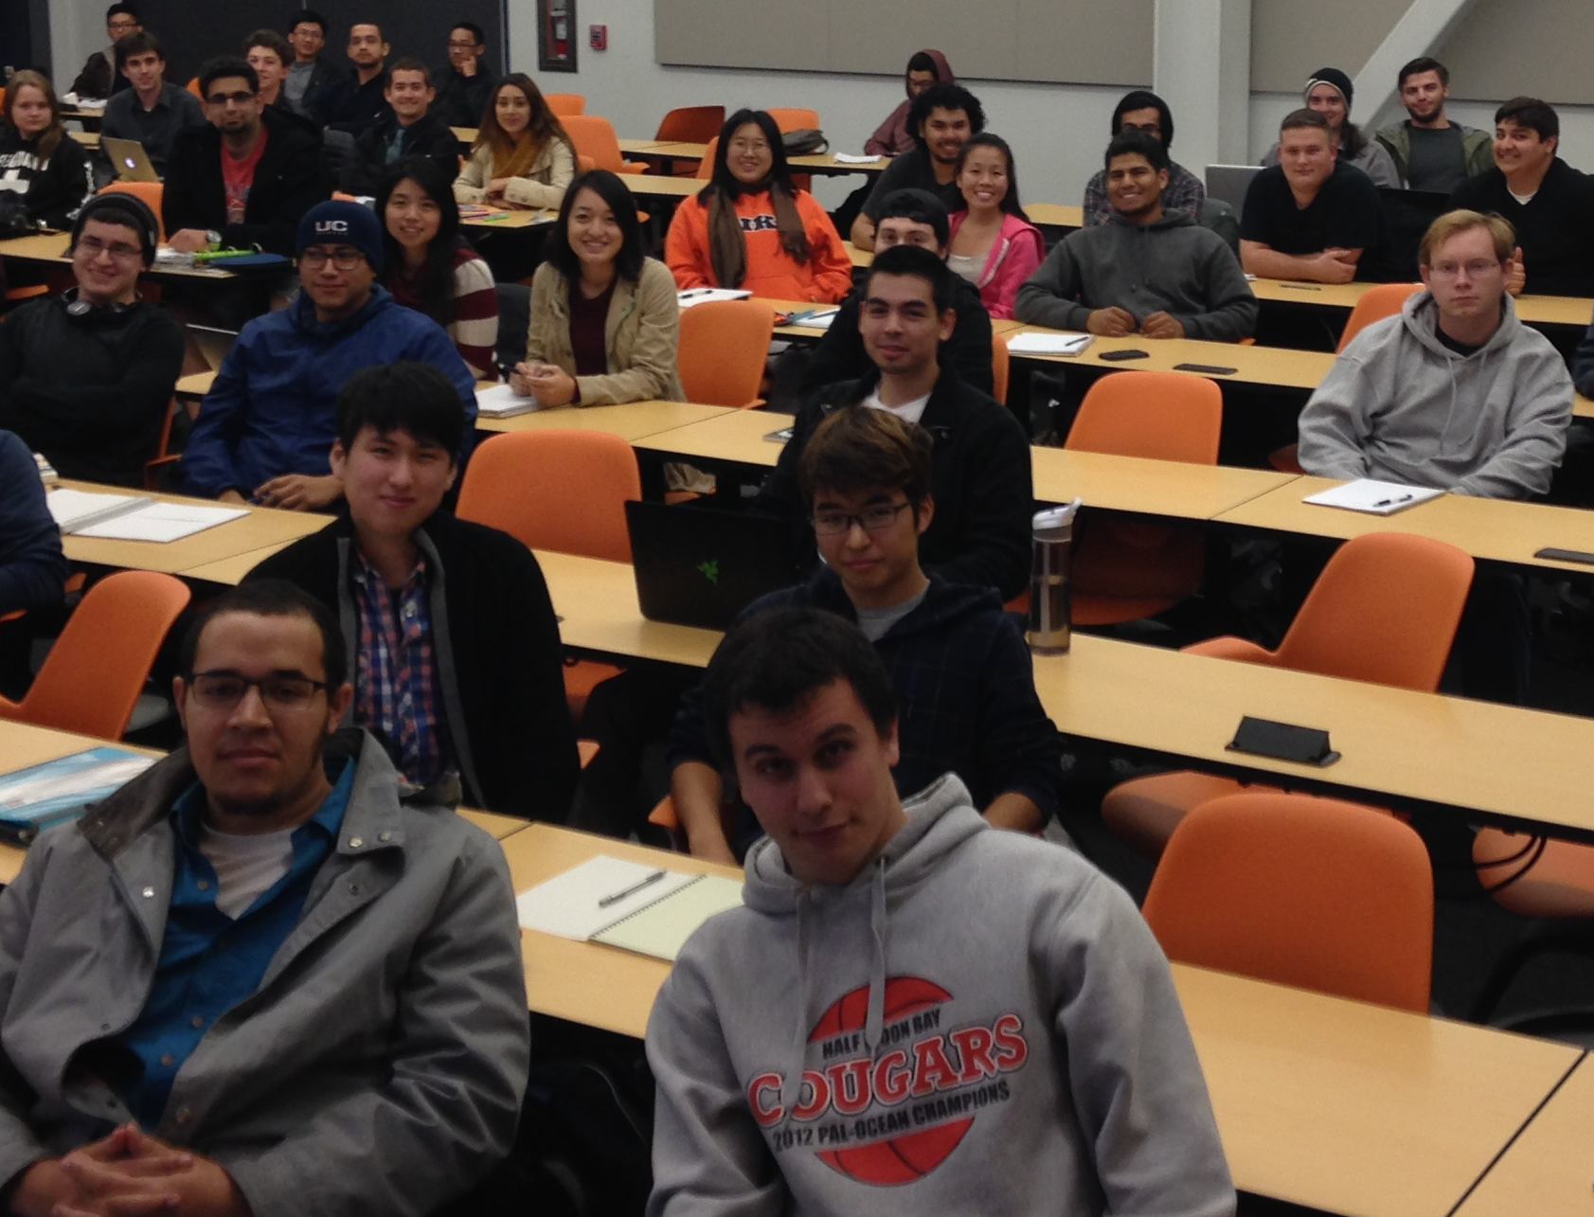
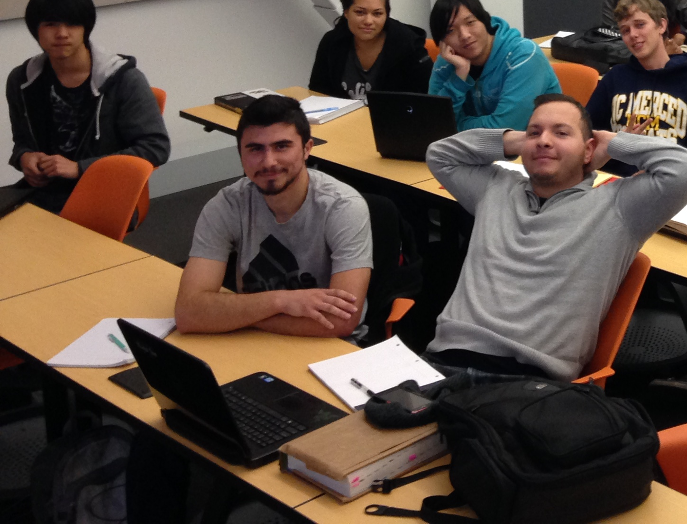
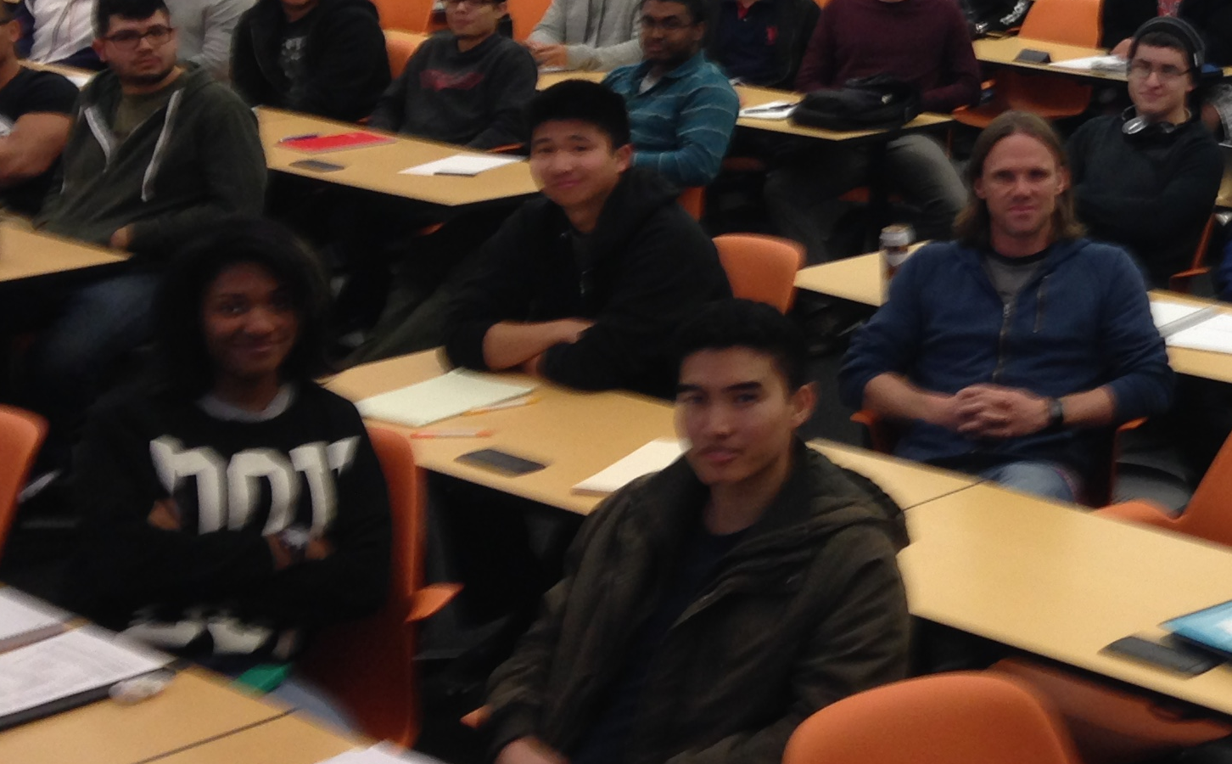
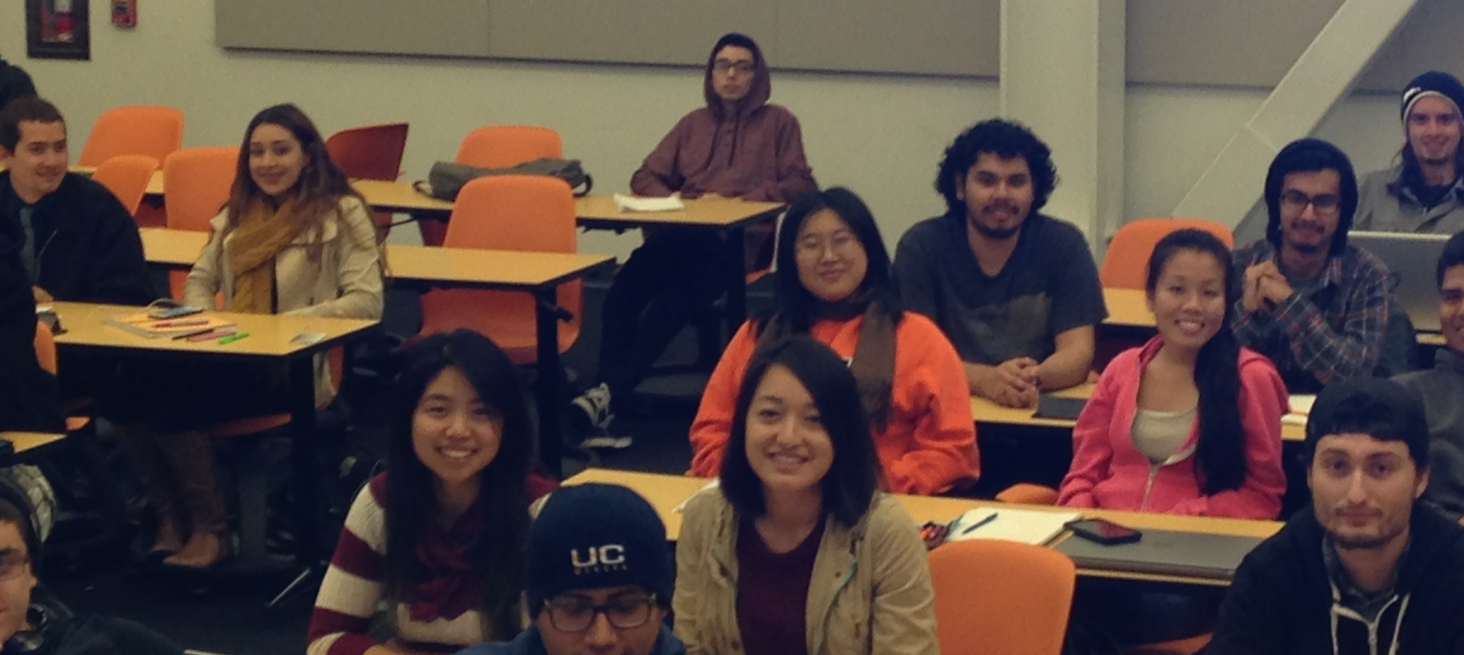
Undergraduate Student Experience
My Expectations:
  GPA > 3.5 (after joining the laboratory).
  Attend every bi-weekly meeting.
  Prepare assigned tasks and deliver them professionally.
  Reach out to senior laboratory members to assist in any way you can.
Possible outcomes:
  Switch laboratory: does not fit in with laboratory vision, mission, and values.
  Graduation: successfully finish all course work in time.
  Successfully apply for graduate school or secure a job.

Slide 11

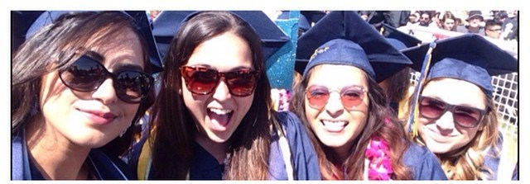
Master Student Experience
 | Plan I - Thesis | Plan II – Non-Thesis
GPA | > 3.0 | > 3.0
Course work | > 20 units of course work > 8 units of research | > 28 units of course work
Graduate seminar | > One semester | > One semester
Final Gate | Thesis defense | Oral comprehensive exam
My Expectations:
  GPA > 3.5; Two years of study; 1 journal publication (Thesis option)
Three possible outcomes:
  Switch advisor: Does not fit in with laboratory research, vision, mission, and values.
  Switch from Plan I to Plan II: Does not meet research expectations.
  Graduation: Successfully pass all requirements in time.

Slide 12
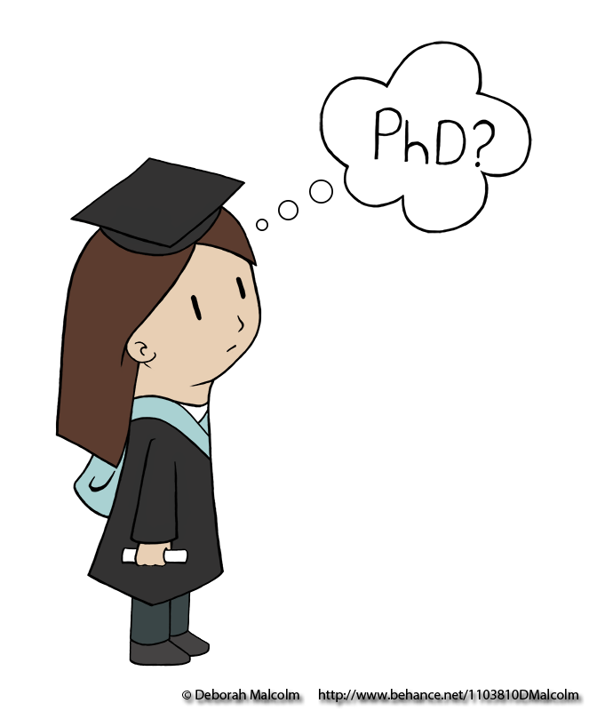
Doctoral Student Experience
My Expectations:
  GPA > 3.7
  Four years of study
  3 journal publications
 | Ph.D.
GPA | > 3.0
Course work (Ph.D.) | > 12 units of course work
Graduate seminar | > Two semesters
Teaching Assistant | > 1 semester
Preliminary exam | Pass < two years
Proposal and Qualify exam | Pass
Conference or Seminar | > 1 presentation
Final Thesis Defense | Pass
Probation period:
  The first 6 months ~ 1 year
  Professor will observe student’s technical capability and learning attitude to determine future plan.
Possible outcomes:
  Switch advisor: Does not fit in with laboratory research, vision, mission, and values.
  Switch from Ph.D. to M.S.:
    Does not pass preliminary exam or qualify exam.
    Does not meet research expectations.
  Graduation: Successfully pass all requirements in time.

Slide 13
Postdoctoral Scholar Experience
Research
  Spend significant hours in the laboratory.
  Perform independent and innovative research everyday.
Writing
  Generate journal publication: more than 2 publications per year.
  Write funding proposal: more than 2 proposals per year.
Teaching
  Teaching can be arranged if there’s a strong interest.
  The opportunity is based on the need of the school.
Mentoring
  Coordinate laboratory research activities.
  Supervise laboratory members including staff, graduate students and undergraduate students.

Slide 14
Time Management
First priority: finish research assignment on time.
3 credit course: devote a maximum of 9 hours weekly including lecture, study, solving homework problems, etc.
50% Teaching Assistantship: devote a maximum of 20 hours weekly.
25% Teaching Assistantship: devote a maximum of 10 hours weekly.
Preparation for preliminary exam and qualifying exam:
  Self-study at night or during the weekend.
To be a successful graduate student, one needs to be goal oriented and be ready for extended working hours.
It is reasonable for a graduate student or research staff to work on an average of 60~80 hours per week.
If you cannot manage your time or work effectively, please record your daily timesheet and schedule a meeting with the professor ASAP.

Slide 15
My Promises to Laboratory Members
I will be available.
I will provide timely and truthful feedback.
I will challenge you to improve.
I will encourage you to learn from your mistakes.
I will listen to your feedback.
I will treat you with respect.
I will do my best to help you succeed.

Slide 16
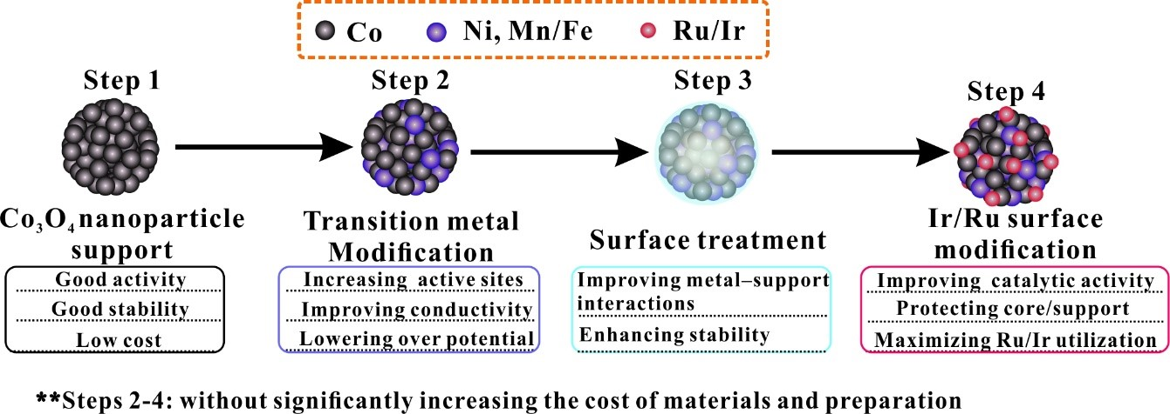
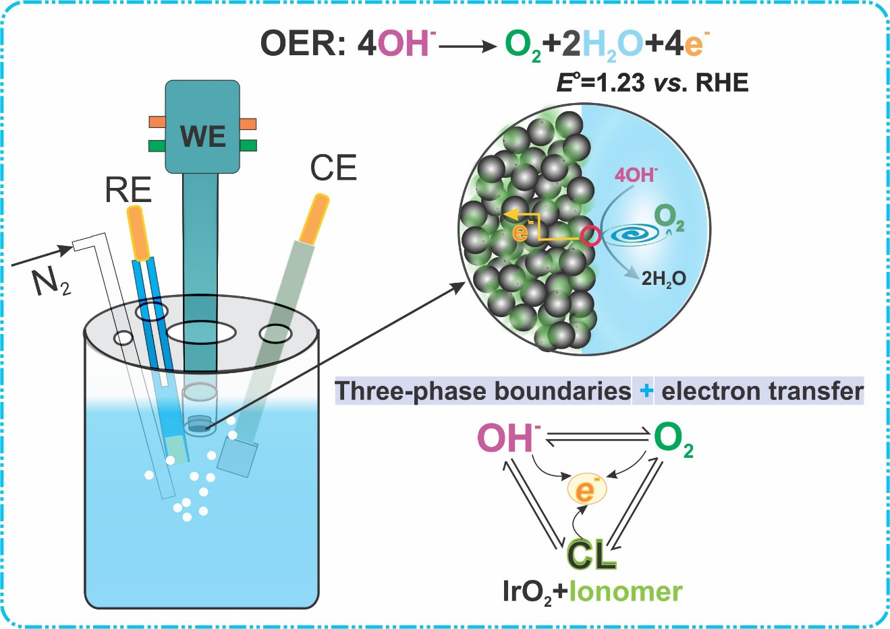

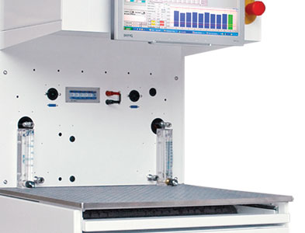
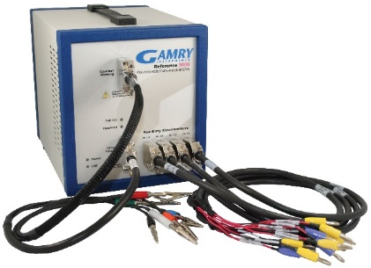
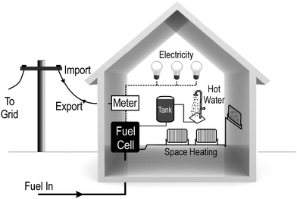
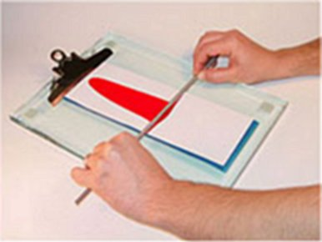
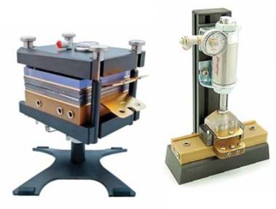
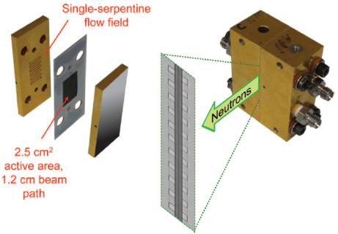
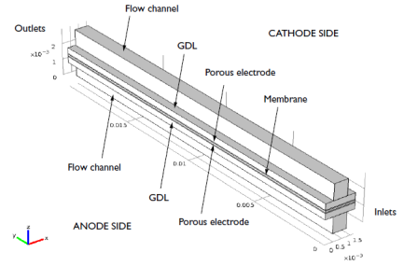
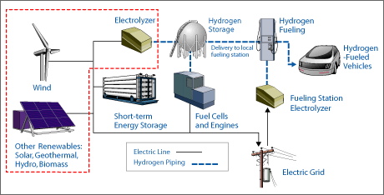
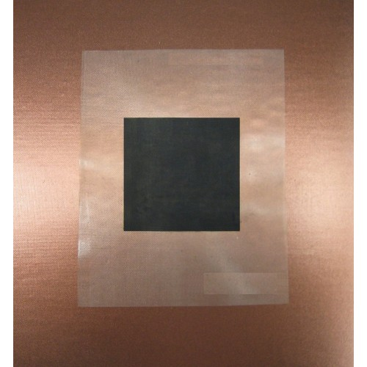
Thermal and Electrochemical Energy Laboratory (TEEL)
Material Synthesis and Evaluation
MEA Integration
Fuel Cell Experiment
Fuel Cell Diagnostic
Fuel Cell Modeling
System Integration
PI: Professor Po-Ya Abel Chuang Email: abel.Chuang@ucmerced.edu Phone: 717-255-9000

Slide 17
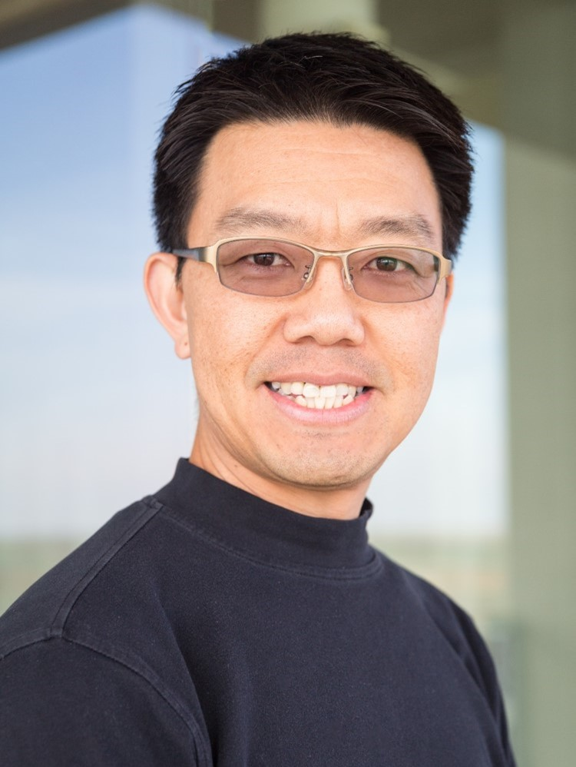
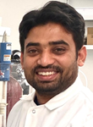
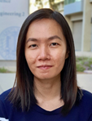
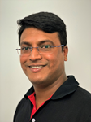
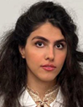
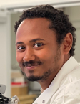
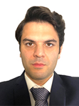
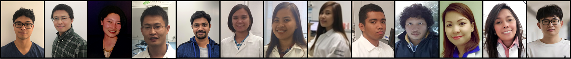
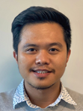
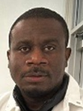
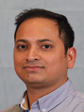
TEEL Laboratory Members
Principle
2003 ME, Penn State University
7 years experience at GM fuel cell team
Fuel Cell, electrolysis, porous media, rheology, simulation, diagnostics
Electrocatalysis
Electrode
Diagnostic
Modeling
Dr. Ayon Karmakar
Joy Marie Mora
Mrittunjoy Sarker
Shadi Salehian
Postdoc
Doctoral Student
Doctoral Student
Doctoral Student
2020 IIT Kharagpur
Electrocatalysis
Electrochemistry
PEM Fuel Cell
AEM Fuel Cell
SOFC Fuel Cell
PEM Fuel Cell
AEM Fuel Cell
CV and EIS
Electrochemistry
Simulation
Robel Mehari Tesfaye
Zabihollah Najafianashrafi
Doctoral Student
Doctoral Student
Electrochemistry
Materials development
Simulation
Porous Transport
Two-phase
Link to our website: https://teel.ucmerced.edu/
Alumni

Slide 18
Any Questions?

